Slide 1

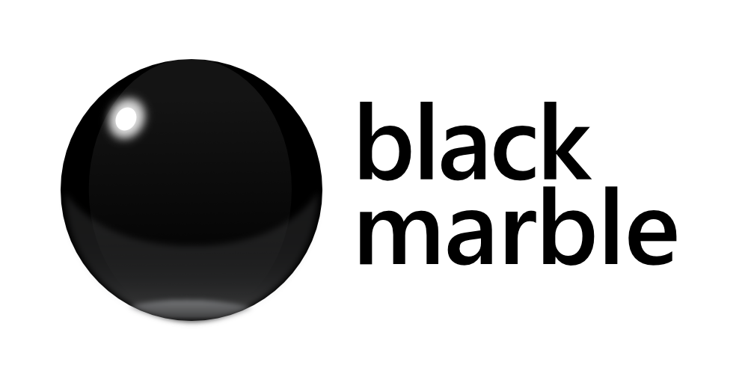

Introduction to Microsoft Bot Framework
and Cognitive Services
@leedssharp
James Mann
Microsoft MVP & Development Consultant
Black Marble @jamesemann

Slide 2


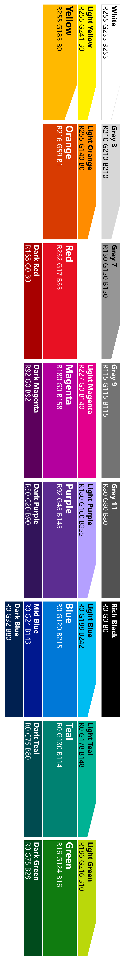
Agenda
Introduction
What is a chatbot?
Why chatbots?
Creating your first bot
Adding bots
Dialogs
Adding middleware
Bot smarts
Qnamaker.ai
luis.ai
Cards
Proactive messaging

Slide 3
Links
https://github.com/jamesemann/leedssharp
Tools:
https://github.com/Microsoft/BotBuilder
https://github.com/Microsoft/BotFramework-Emulator
Services:
https://www.luis.ai
https://www.qnamaker.ai
https://portal.azure.com

Slide 4
What is a chatbot?
@jamesemann

Slide 5
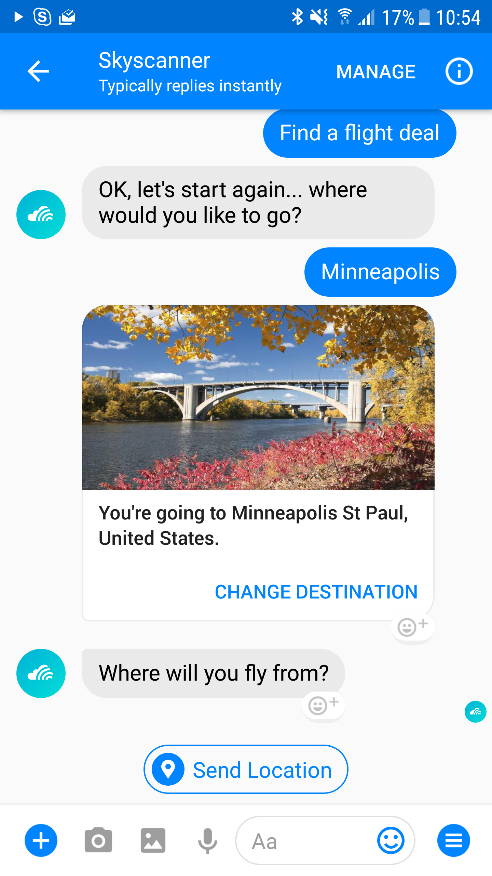

Slide 6


Slide 7
Why chatbots?
@jamesemann

Slide 8
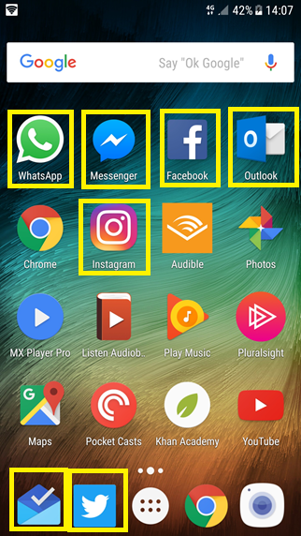
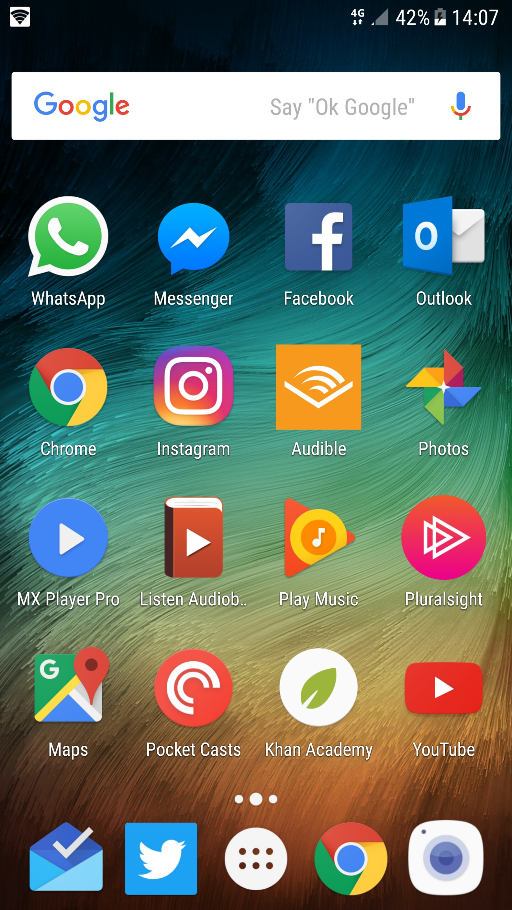
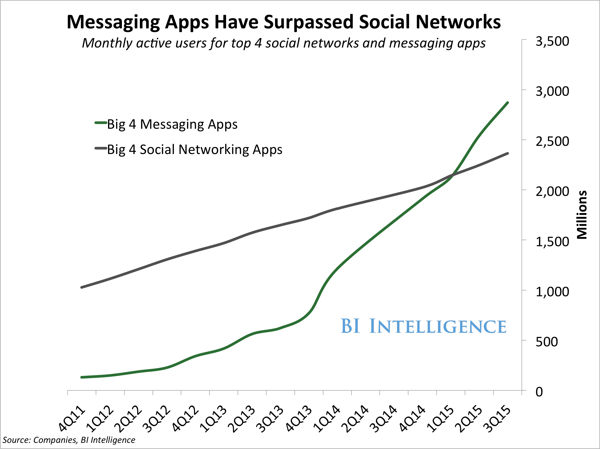
Distribution
Over 4 billion global users using messaging platforms
6 out of the top 10 apps used globally are messaging apps

Slide 9














Messaging ecosystem

Slide 10
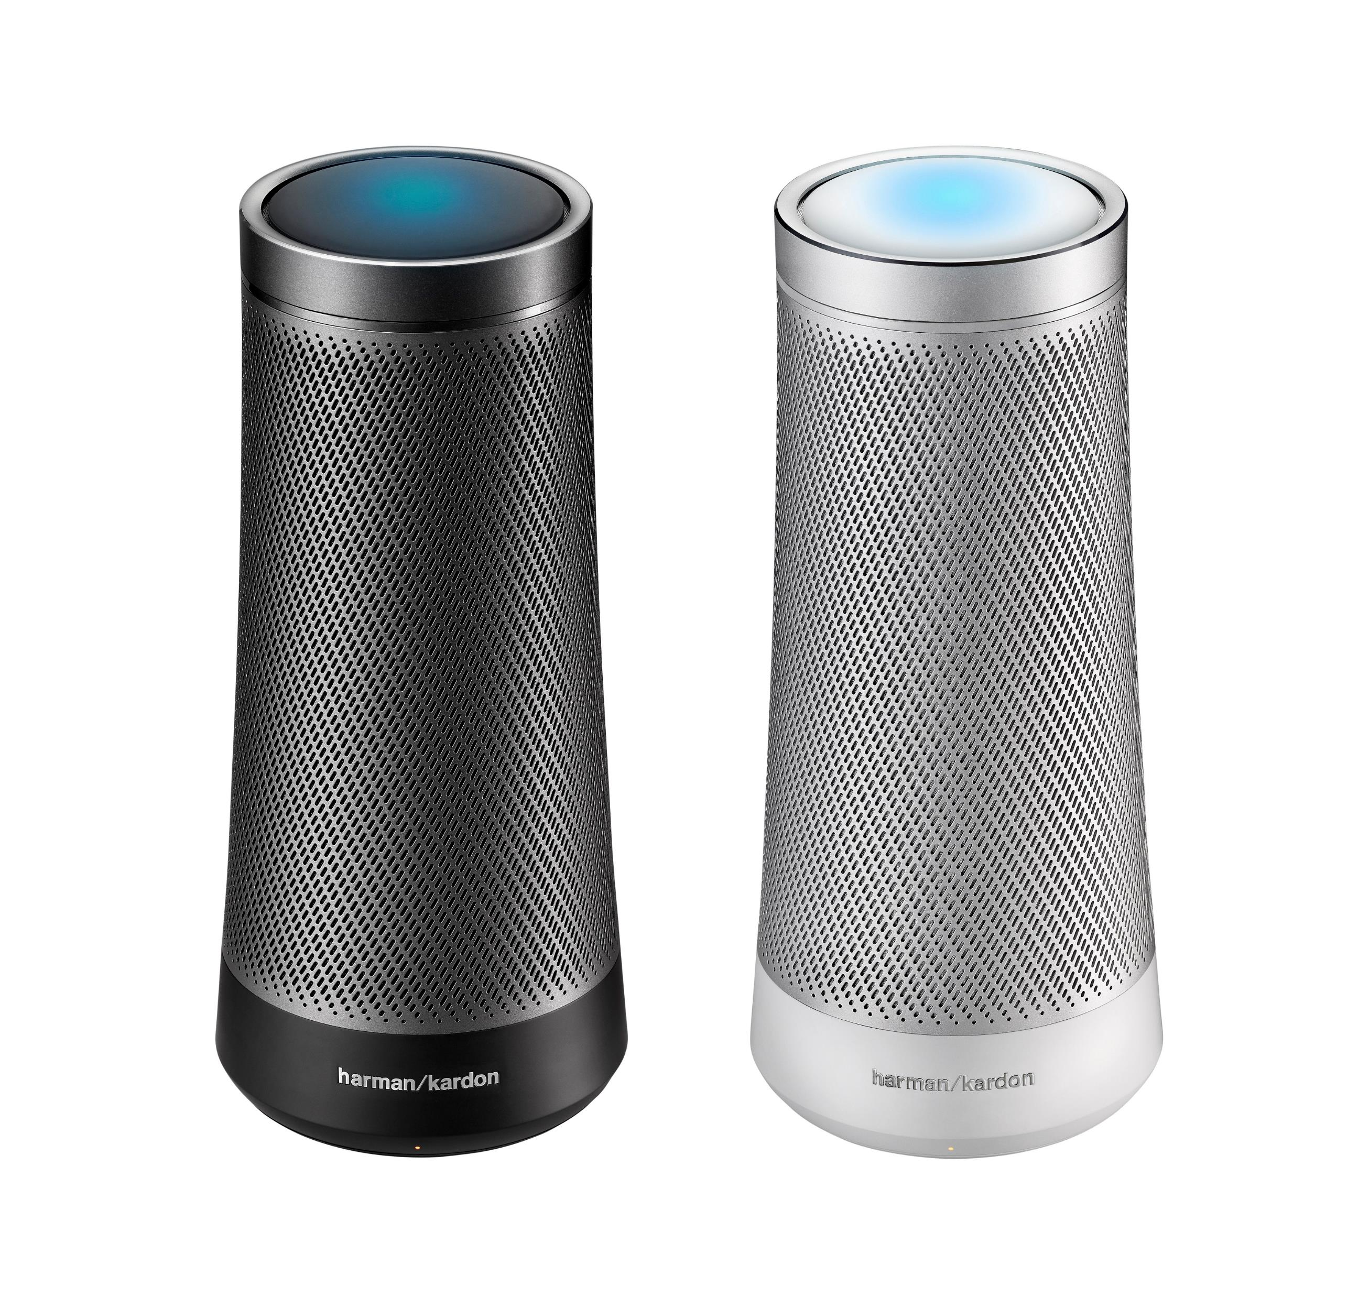
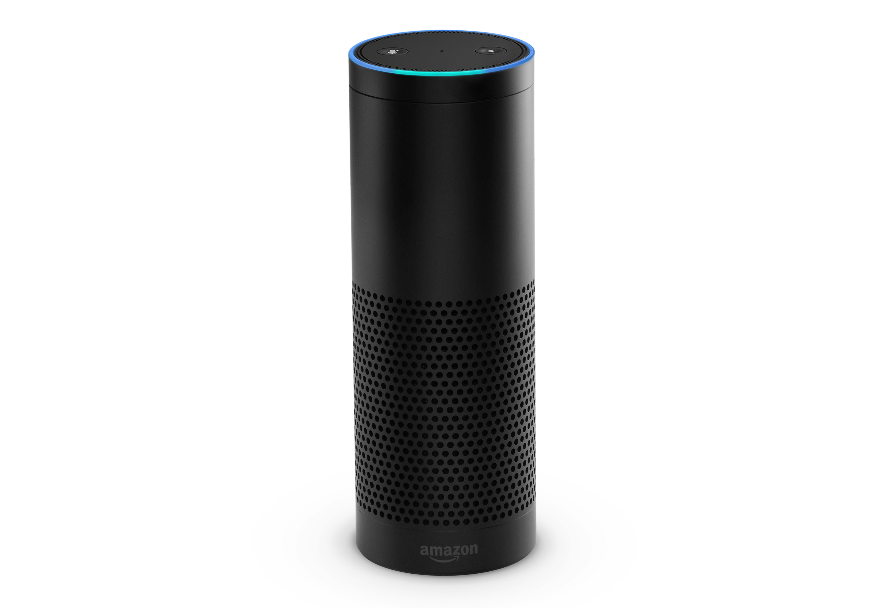
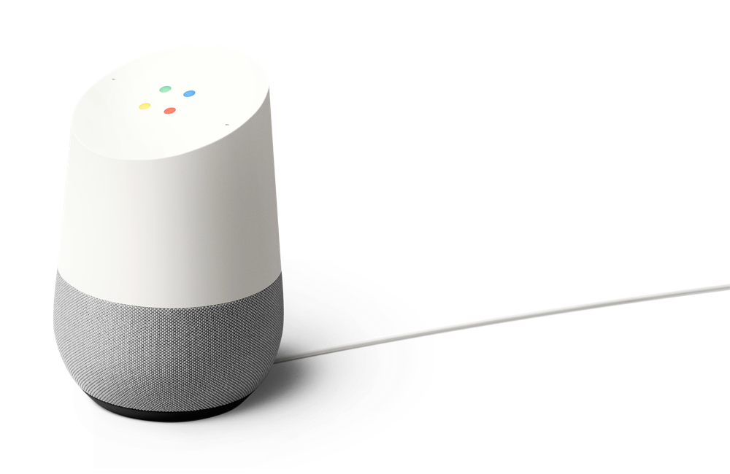
Virtual assistant device ecosystem

Slide 11
Use cases are everywhere
Customer Service
Shopping Experience
Help Desk
Employee Support
FAQ
Account queries
Resolve order issues
Parcel Tracking
Transport queries (bus, train)
Recommend product
Flight, hotel booking
Improving search
Find the right product
Problem troubleshooting
New user on-boarding
Response suggestion
Product information
Data insights
Find the right expert
HR – booking holiday, fault reporting
Meeting room booking

Slide 12
Creating your first bot
@jamesemann

Slide 13
Targeting multiple channels is complex
How do you make a chatbot work with both Slack and Teams?
What about bringing an existing chatbot to new channels?
It would mean rewriting large amounts of code

Slide 14
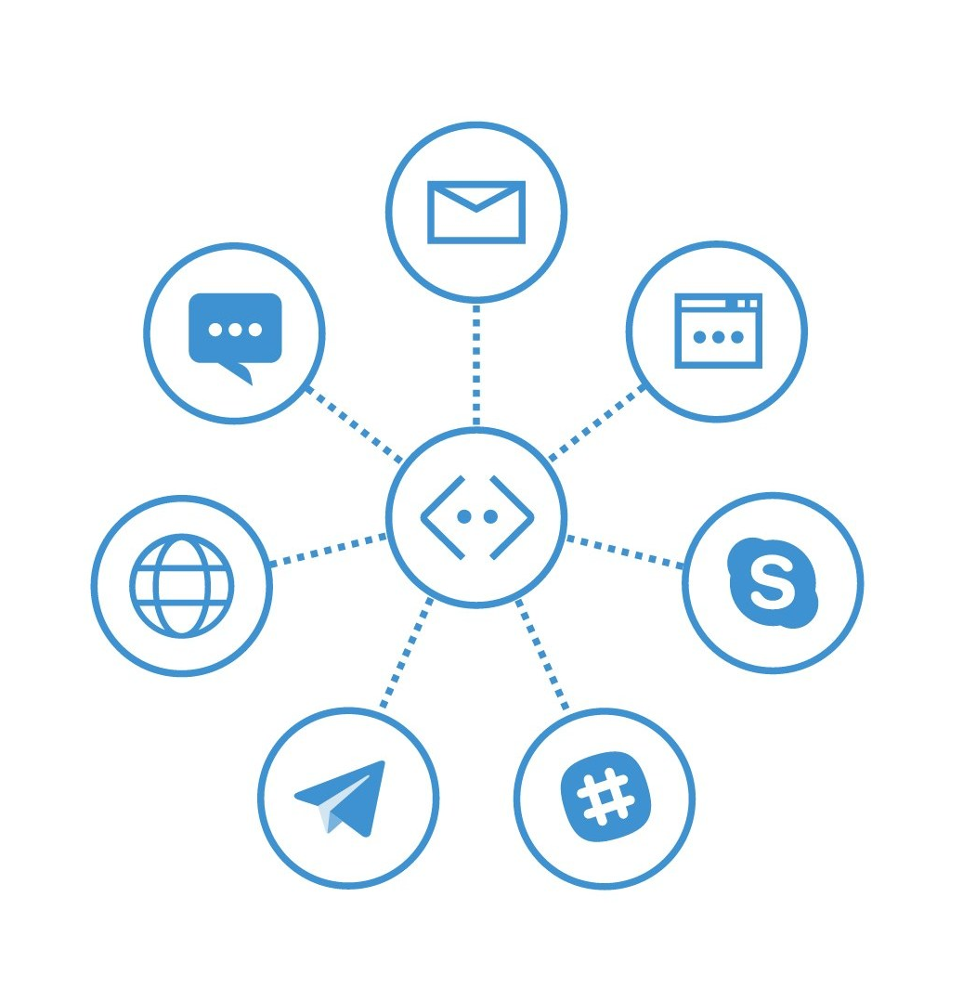
Bot Framework
Build one Bot
Host one Bot
Maintain one Bot
Target multiple channels

Slide 15
BotBuilder v4
A response to the developer community
Less opinionated
4 flavours (.NET core, Node, Python & Java)
Bring your own implementation (ioc, logging, persistence etc)
Bring your own tooling
Languages are more aligned
Follow same principles, language semantics are different

Slide 16
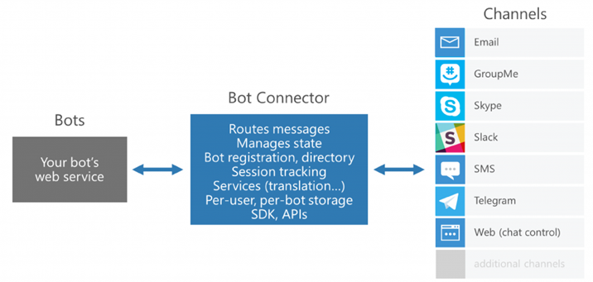
Bot Framework architecture

Slide 17
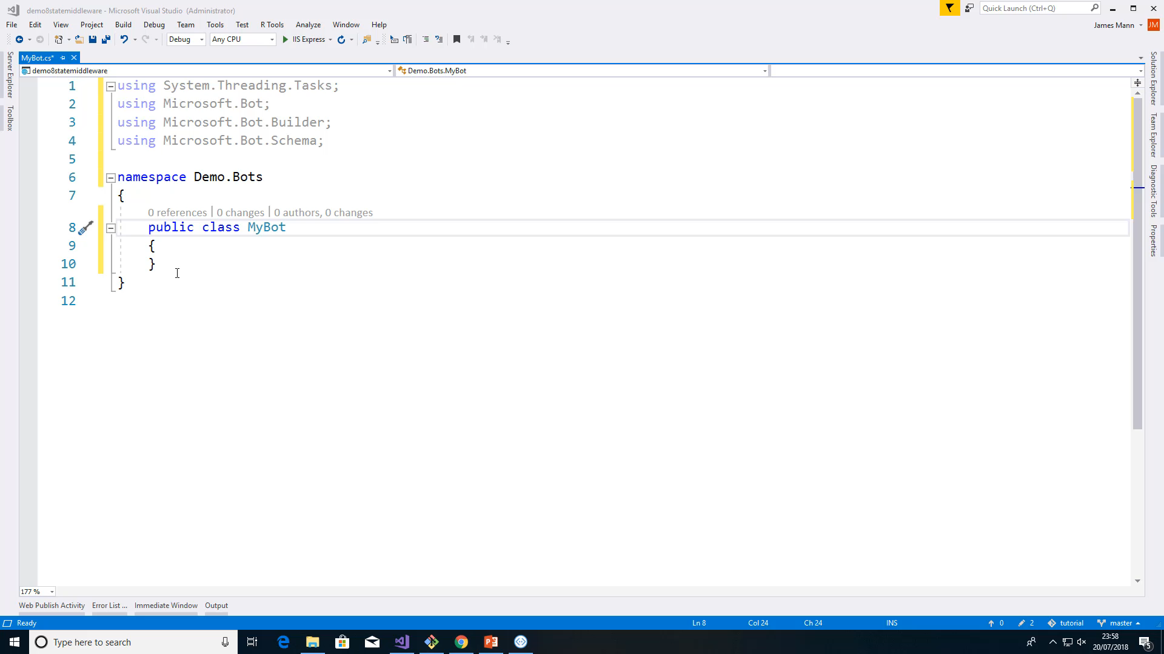
Step 1: Build
Build your chatbot using
.NET
JavaScript
Python
Java

Slide 18
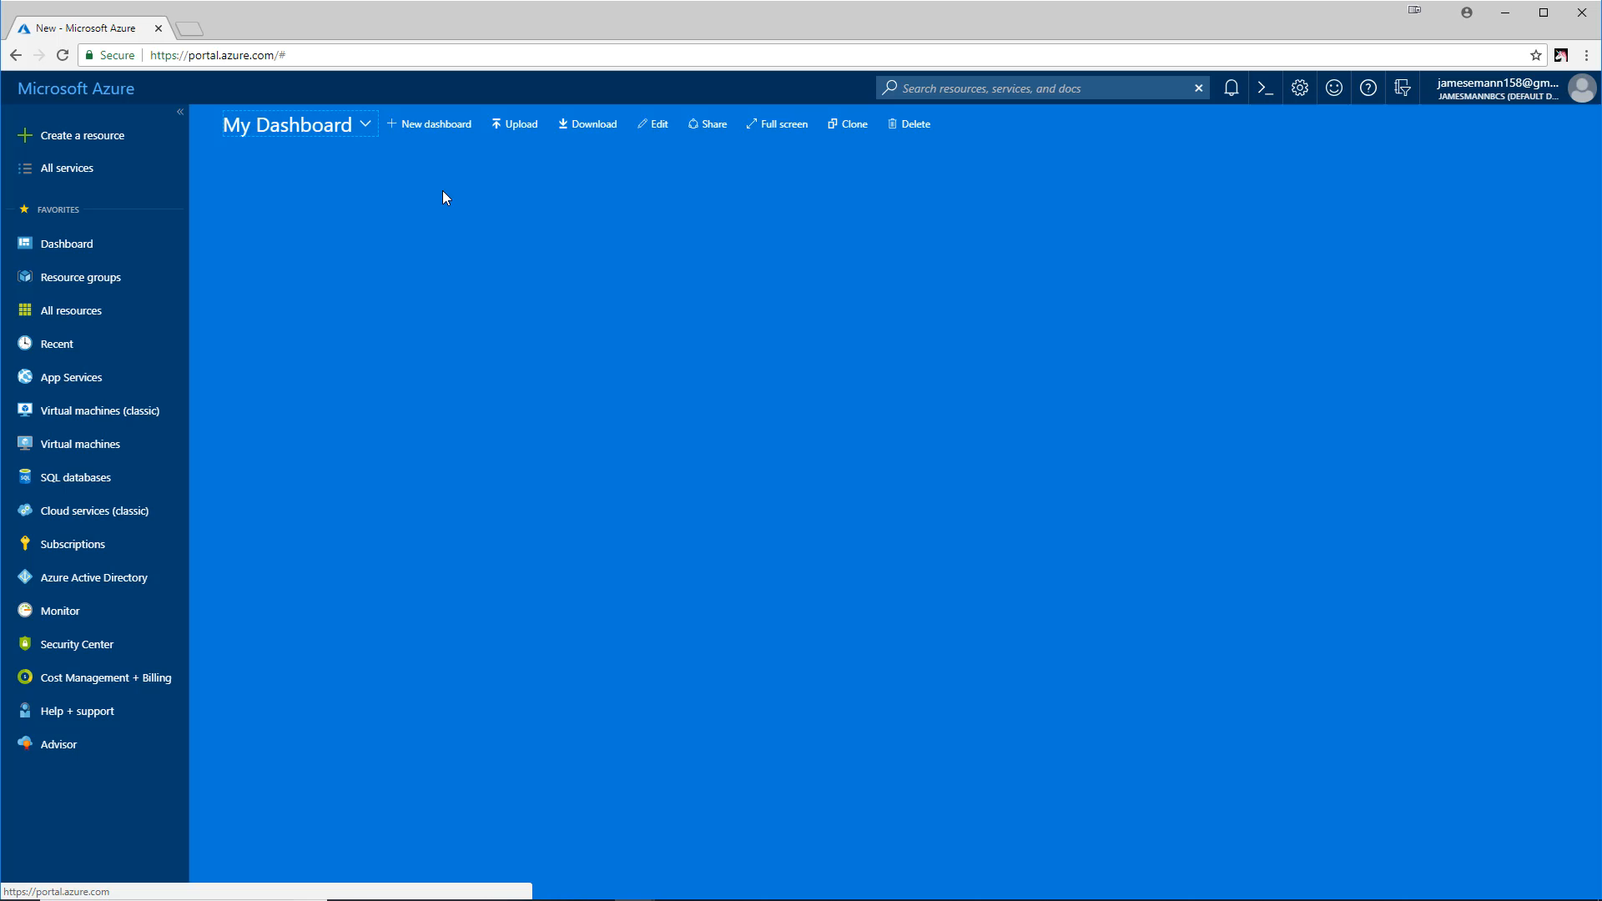
Step 2: Register
Register your chatbot using
Azure CLI msbot extension
Azure Portal

Slide 19
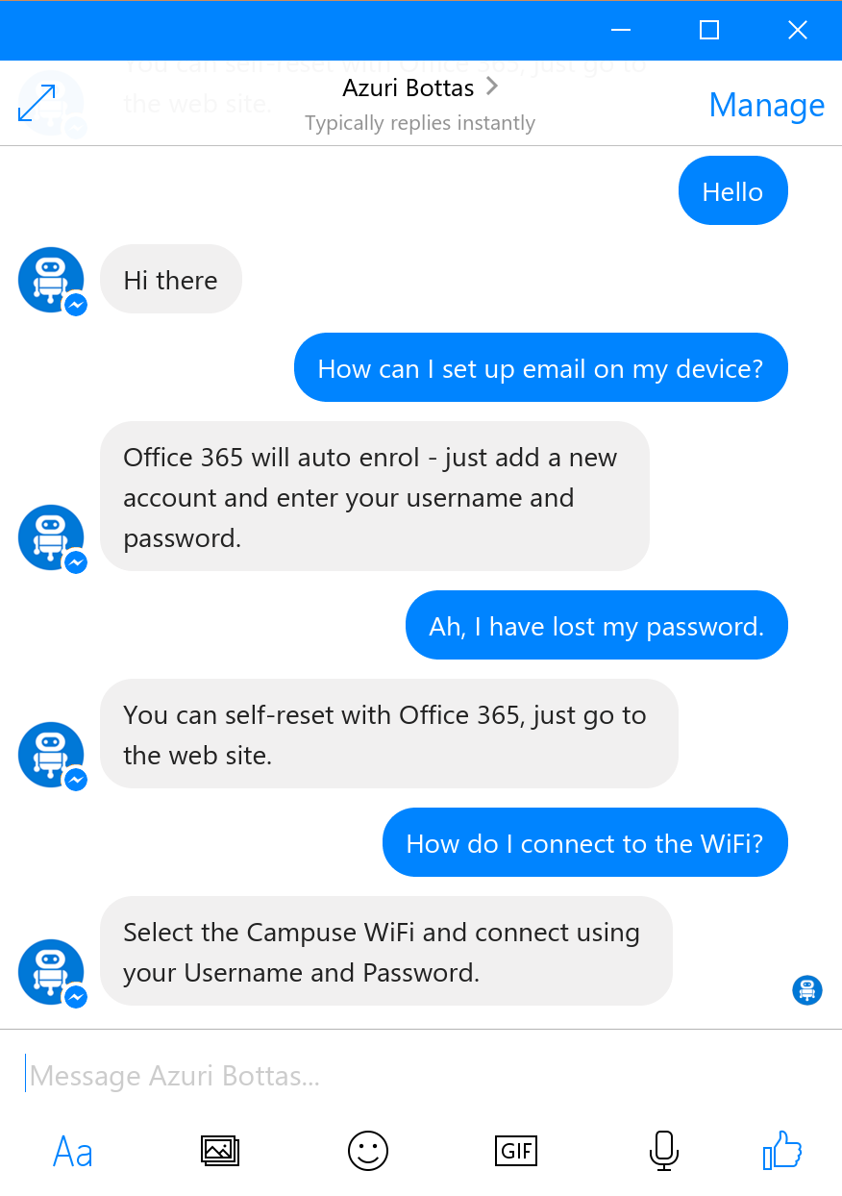
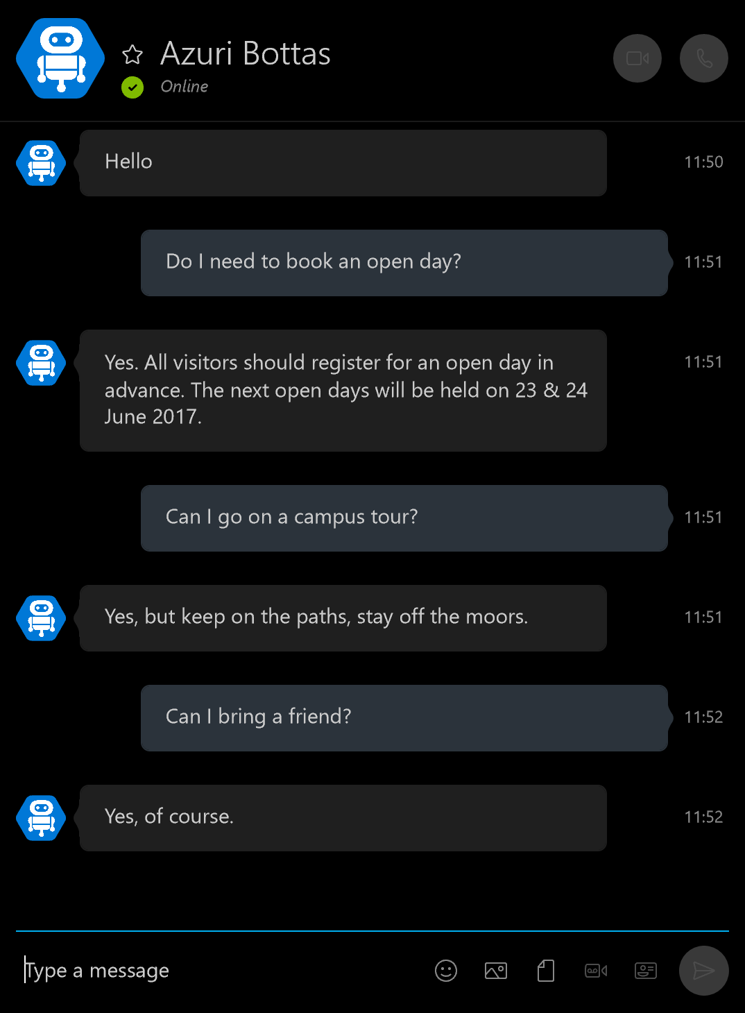









Distribute
Facebook Messenger
Skype
& more!

Slide 20
Demo
Your first bot
@jamesemann

Slide 21
Modelling your conversation
Roll your own
state management etc
Bespoke
Multi layered conversations
Multiple turn (Dialogs)
Flexibility
Questions and answers/FAQ
Single turn
Effort to implement

Slide 22
Adding bots
@jamesemann

Slide 23
Bots
To implement a bot, create an instance of IBot
Your bot must implement OnTurn()
OnTurn() is called every time a message is received

Slide 24
Adding bots – Step 1
Create a class which implements IBot
public class MyBot : IBot
{
public async Task OnTurn(ITurnContext turnContext)
{
if (turnContext.Activity.Type == ActivityTypes.Message)
{
await turnContext.SendActivity($"You said {turnContext.Activity.Text}");
}
}
}
Indent 1.3cm

Slide 25
Adding bots – Step 2
Register the class in Startup.cs
services.AddBot<SimpleBot>(options => {} );
Indent 1.3cm

Slide 26
Adding middleware
@jamesemann

Slide 27
Middleware
Middleware is cross-cutting functionality which is useful and reusable by different bots. For example:
Conversation state
Error handling
Natural language recognition or sentiment analysis
…

Slide 28
Middleware pipeline
The Middleware pipeline contains:
0 or more IMiddleware classes
1 IBot class
next() invokes the next component in the pipeline.
If a piece of Middleware does not call next(), processing ends

Slide 29
Middleware pipeline
Middleware 1
Middleware 2
Bot
Start turn
// do something before
next()
// do something before
next()
doSomething()
// do something after
// do something after
End turn

Slide 30
Adding middleware – Step 1
Create a class which implements IMiddleware
public class PassthroughMiddleware : IMiddleware
{
public async Task OnTurn(ITurnContext context, MiddlewareSet.NextDelegate next)
{
await context.SendActivity("I run before every received activity");
await next();
await context.SendActivity("I run after every received activity");
}
}
Indent 1.3cm

Slide 31
Adding middleware – Step 2
Register the class in Startup.cs
services.AddBot<SimpleBot>(options =>
{
options.Middleware.Add(new PassthroughMiddleware());
});
Indent 1.3cm

Slide 32
Demo
Adding passthrough middleware
@jamesemann

Slide 33
Dialogs
@jamesemann

Slide 34
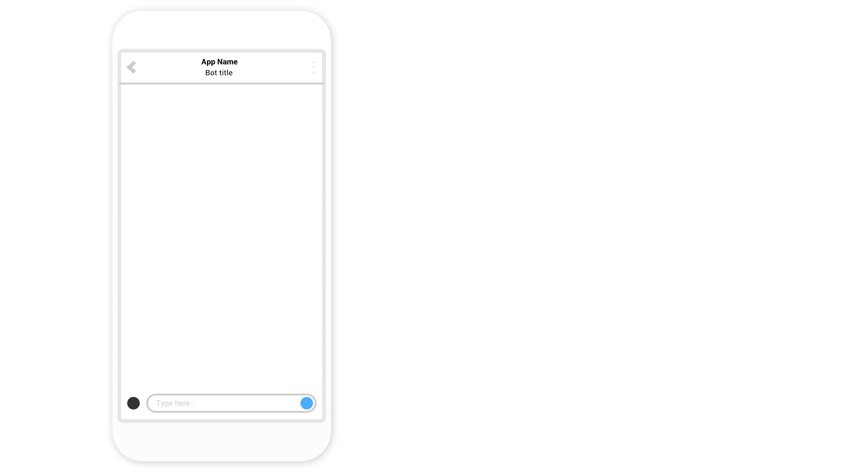

Slide 36


Slide 37
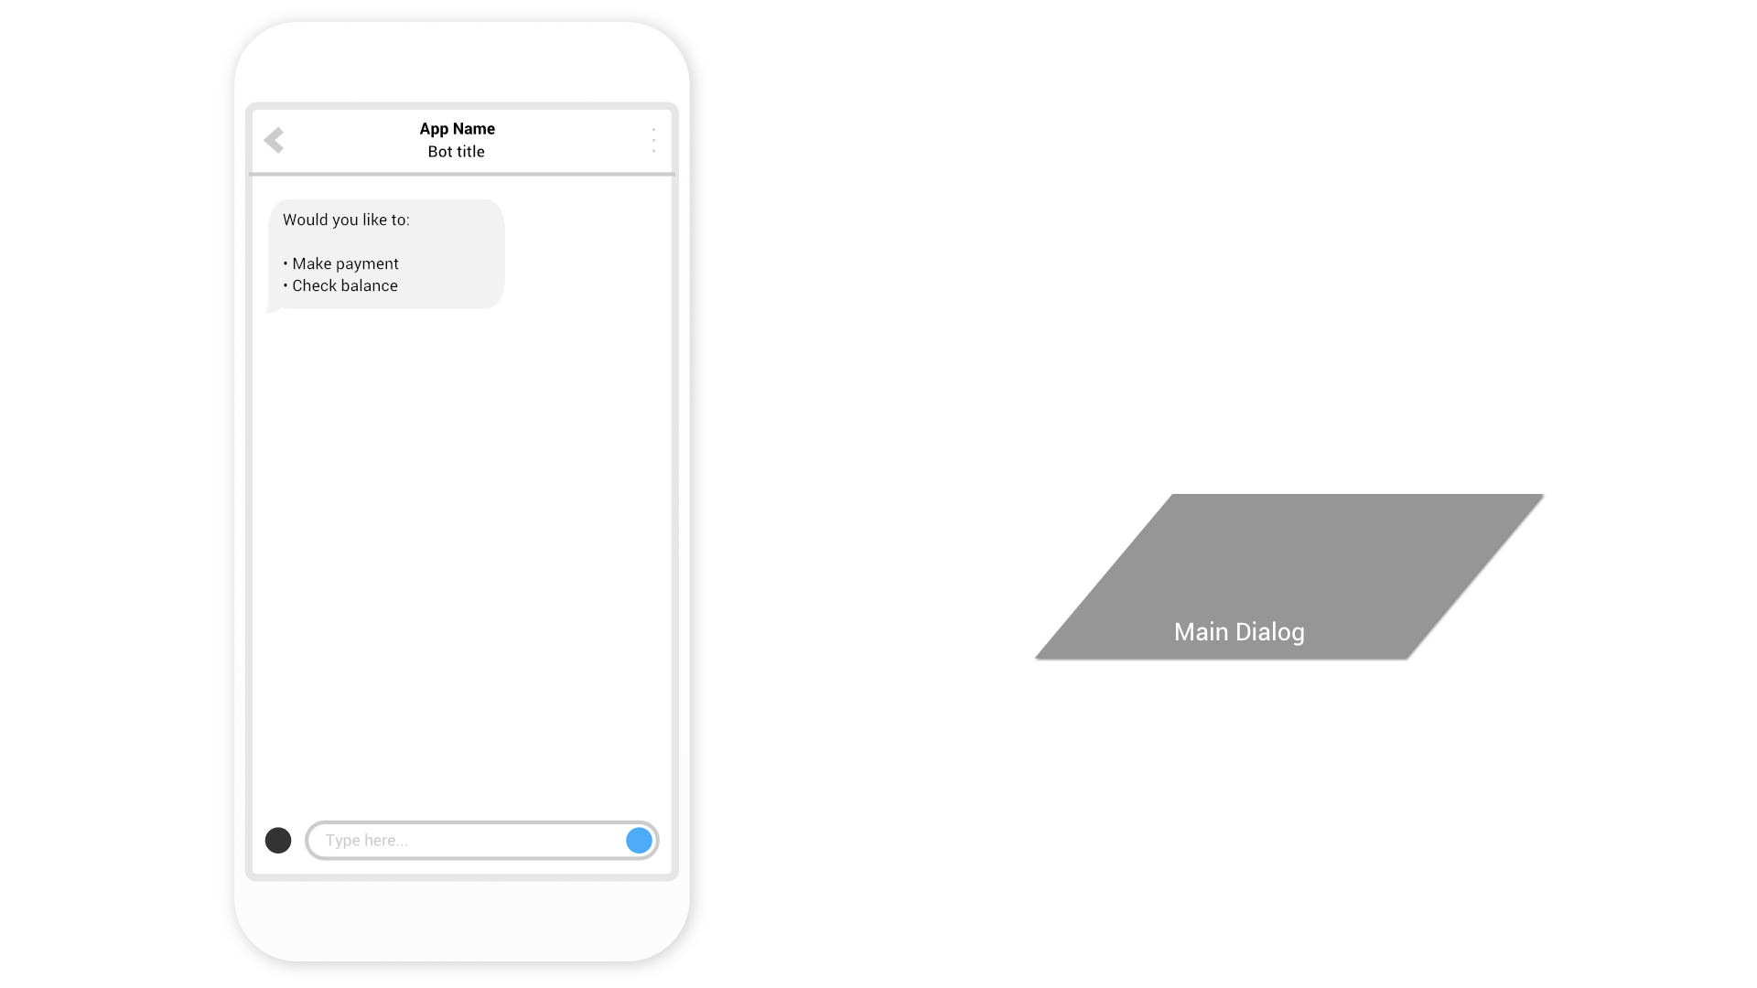

Slide 38
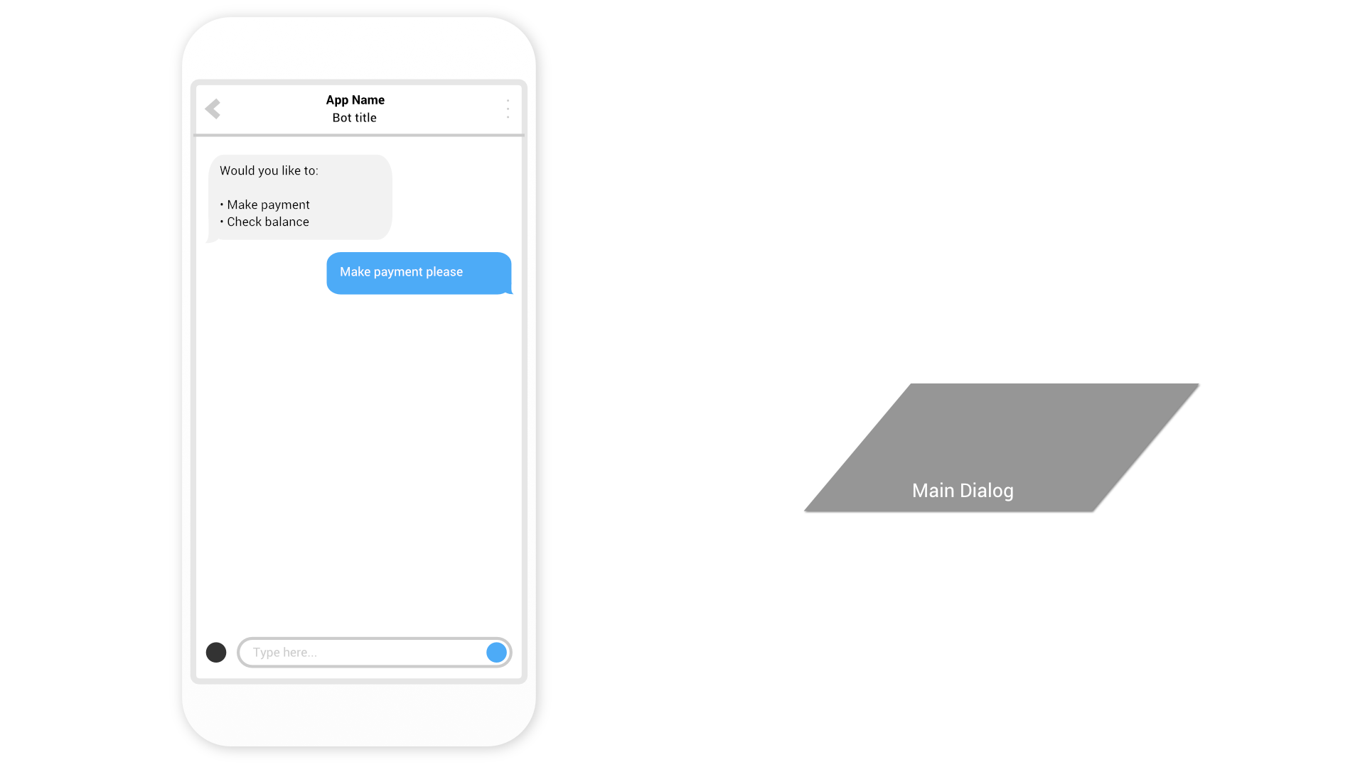

Slide 39
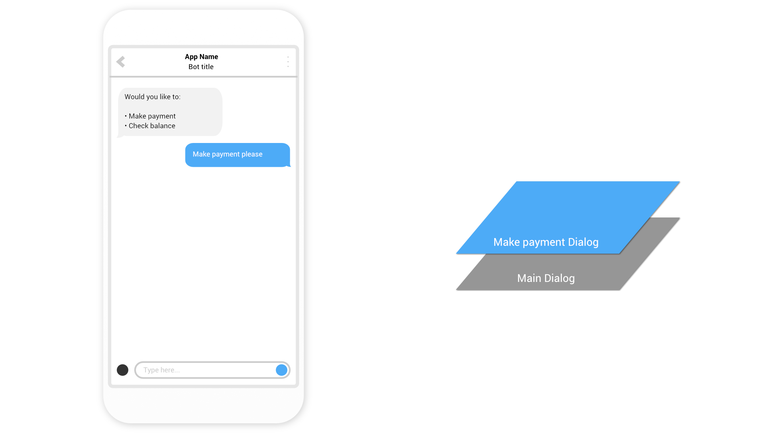

Slide 40


Slide 41
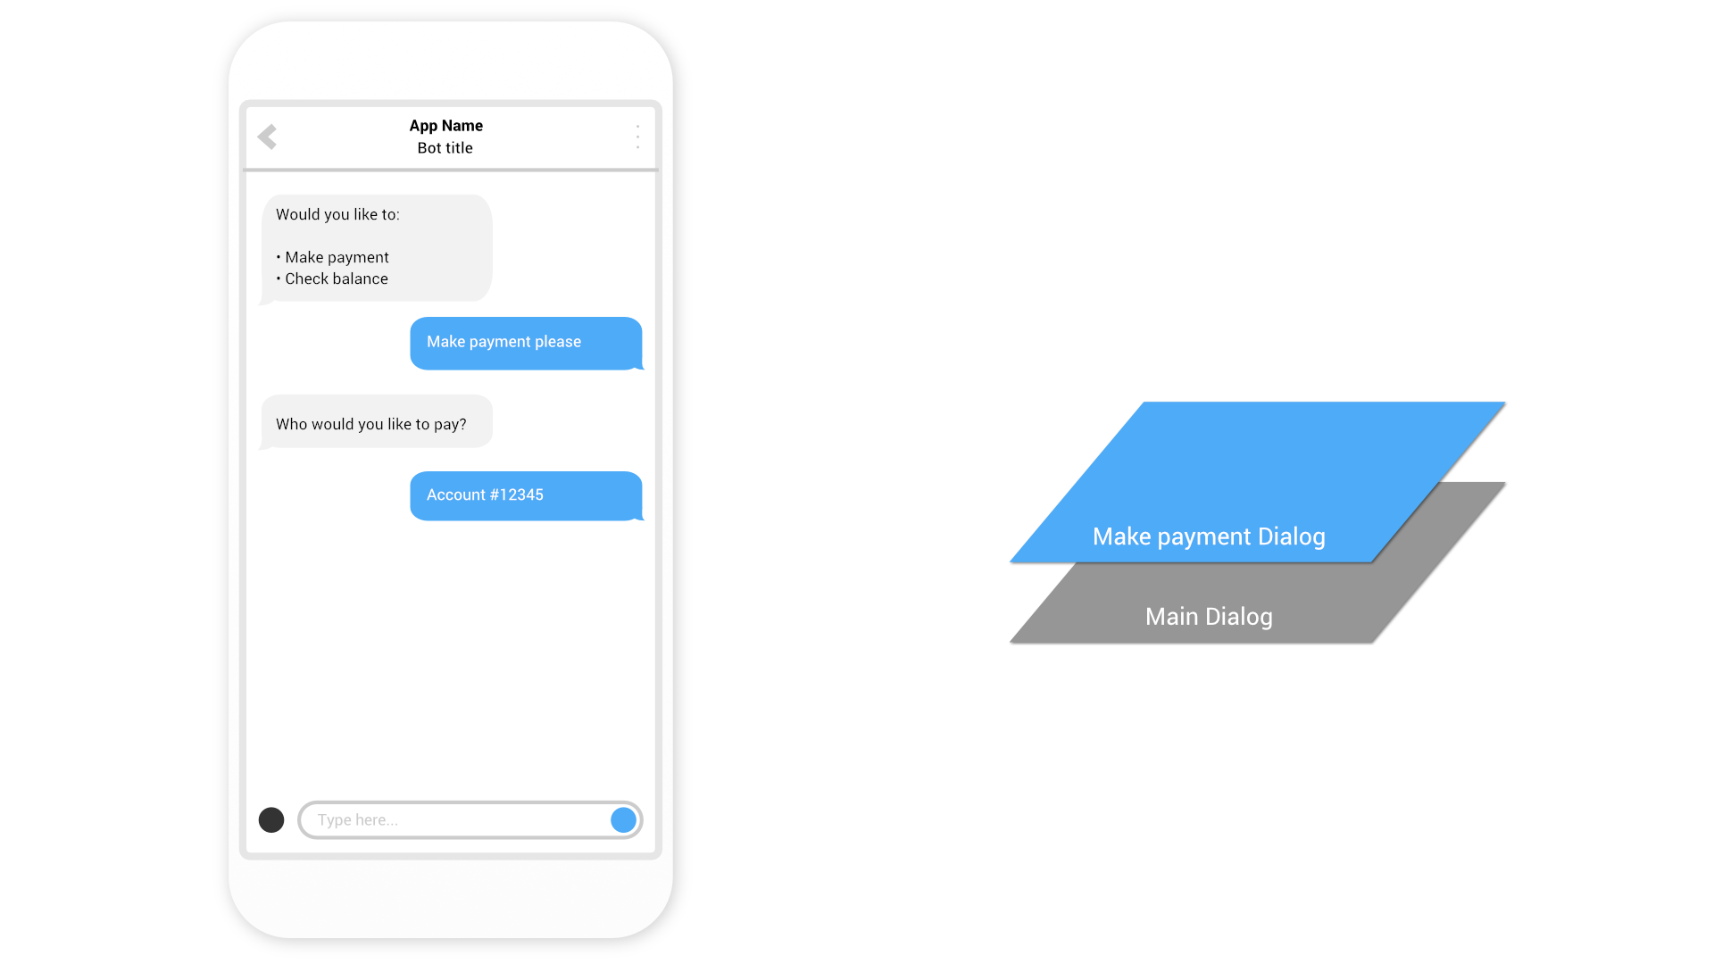

Slide 42


Slide 43
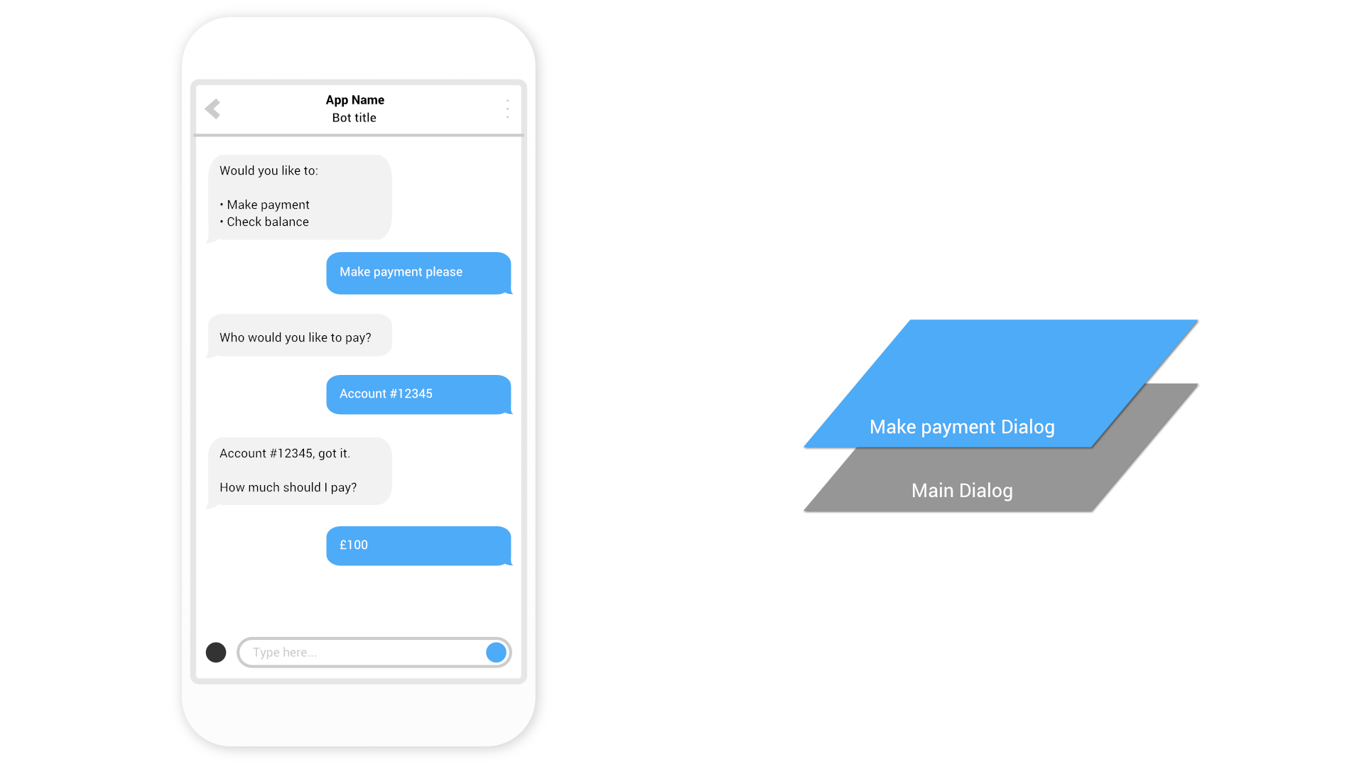

Slide 44
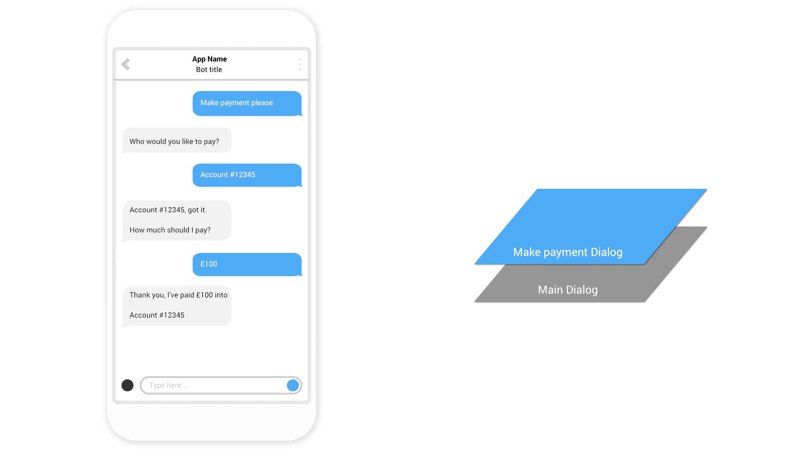

Slide 45
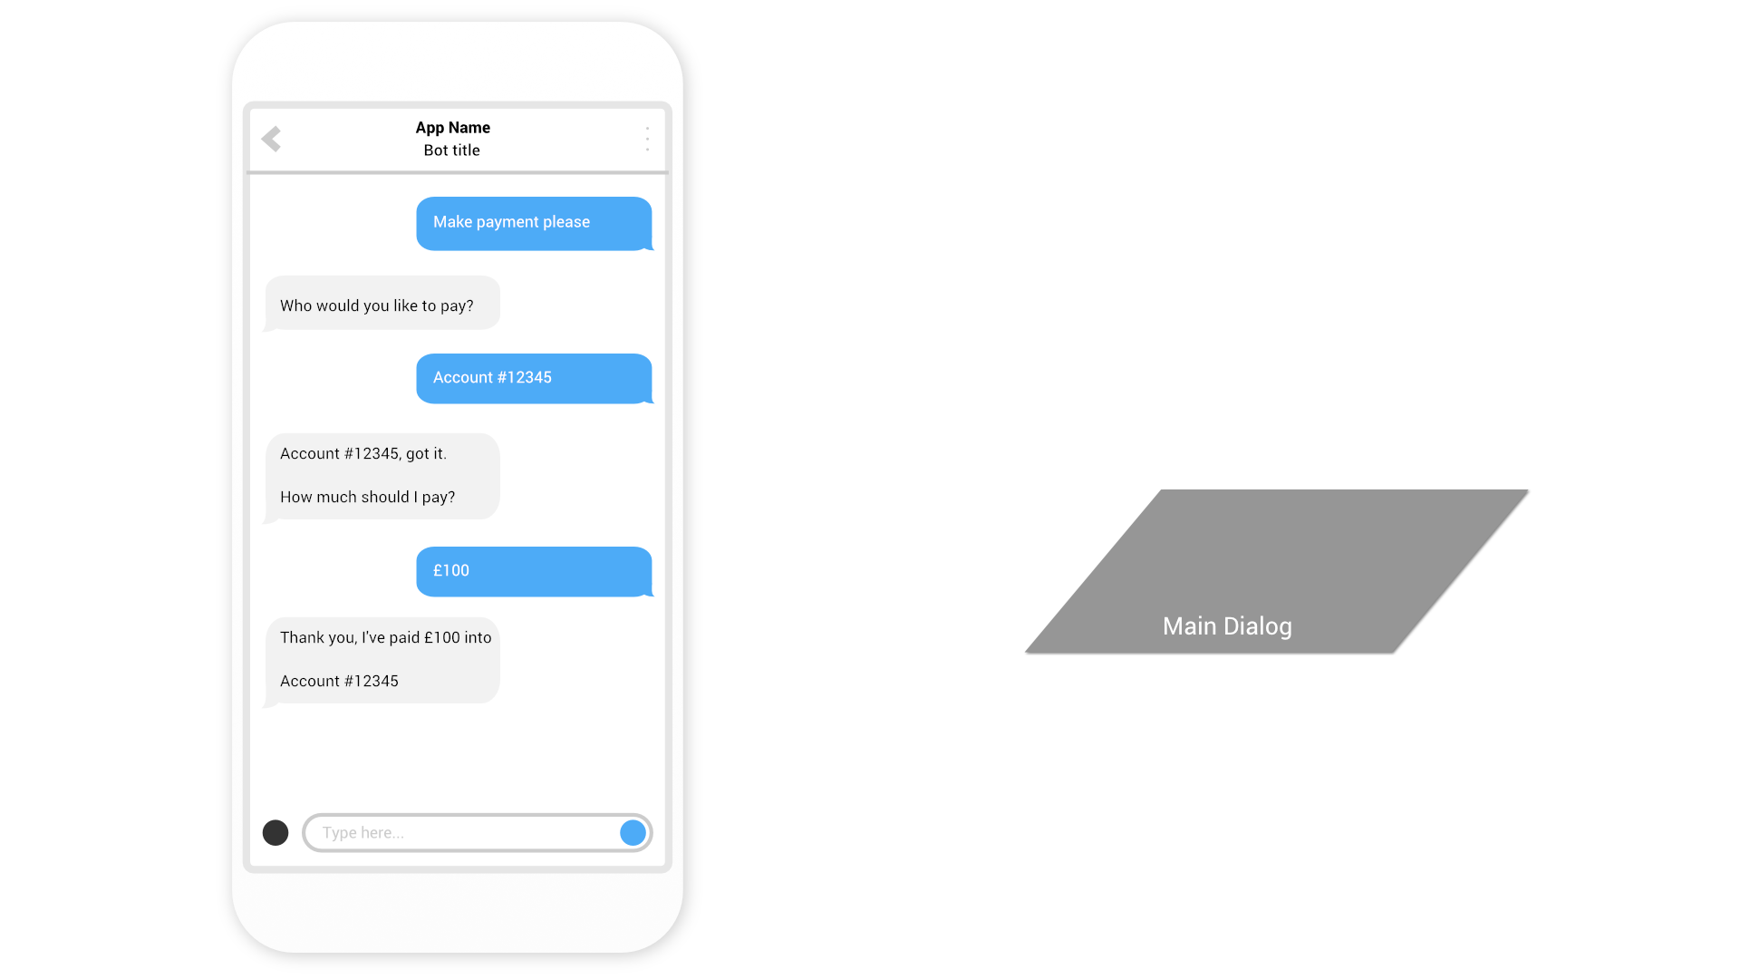

Slide 46
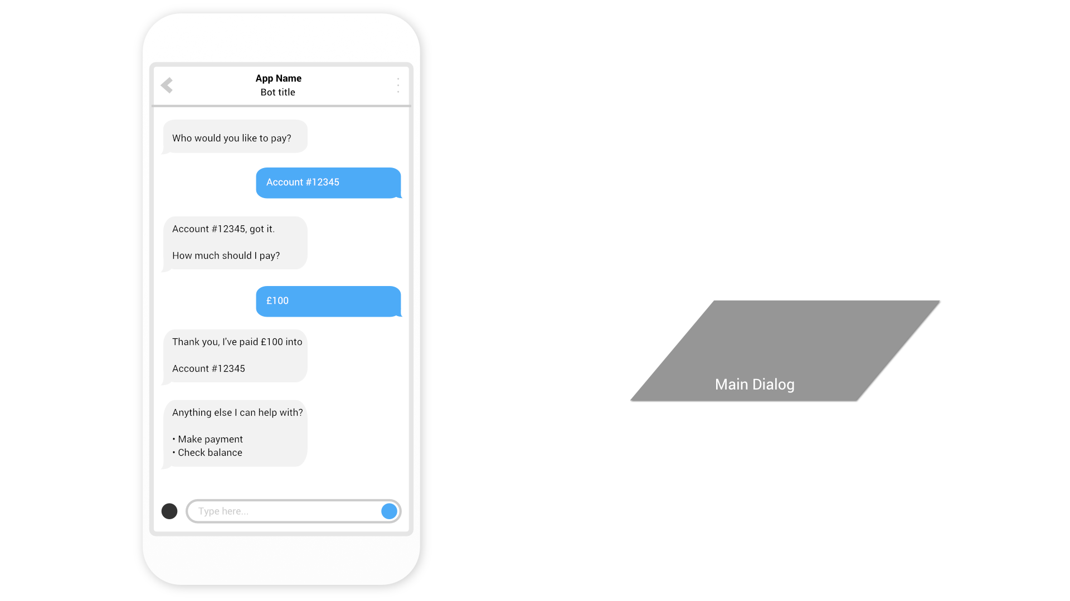

Slide 47
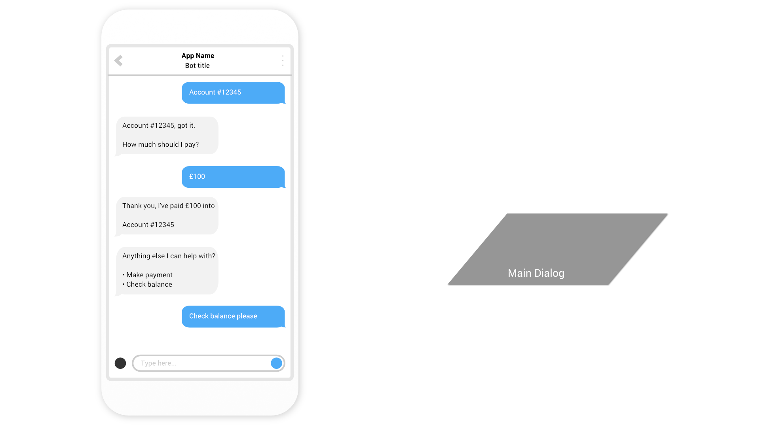

Slide 48
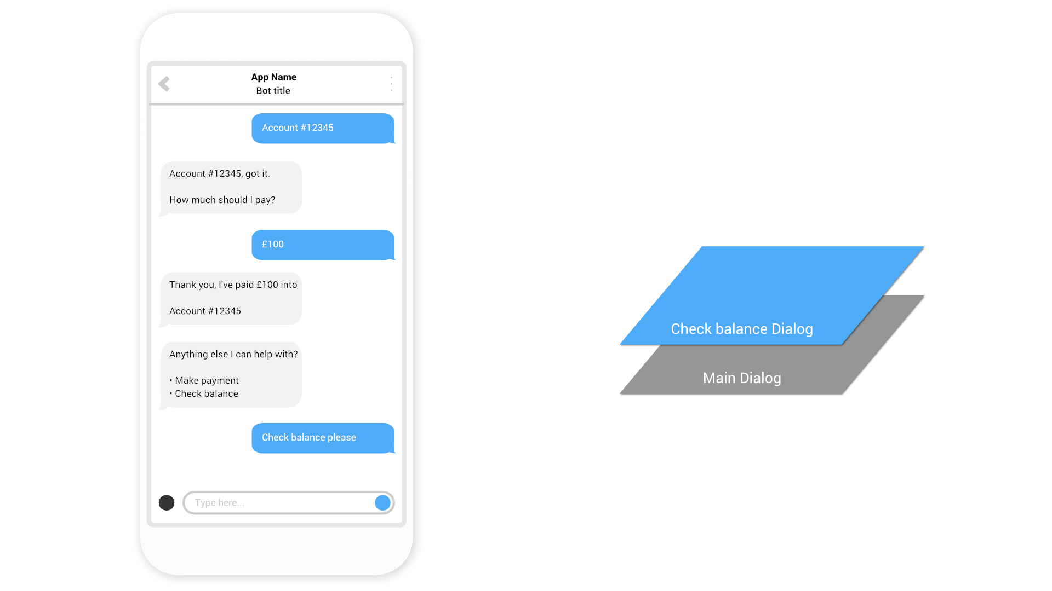

Slide 49
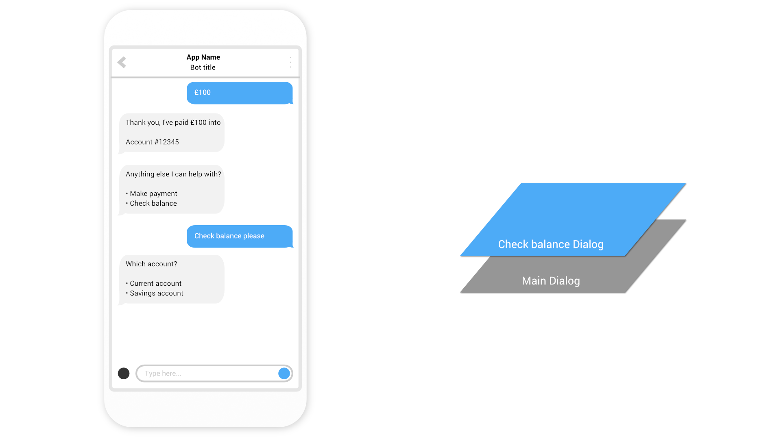

Slide 50
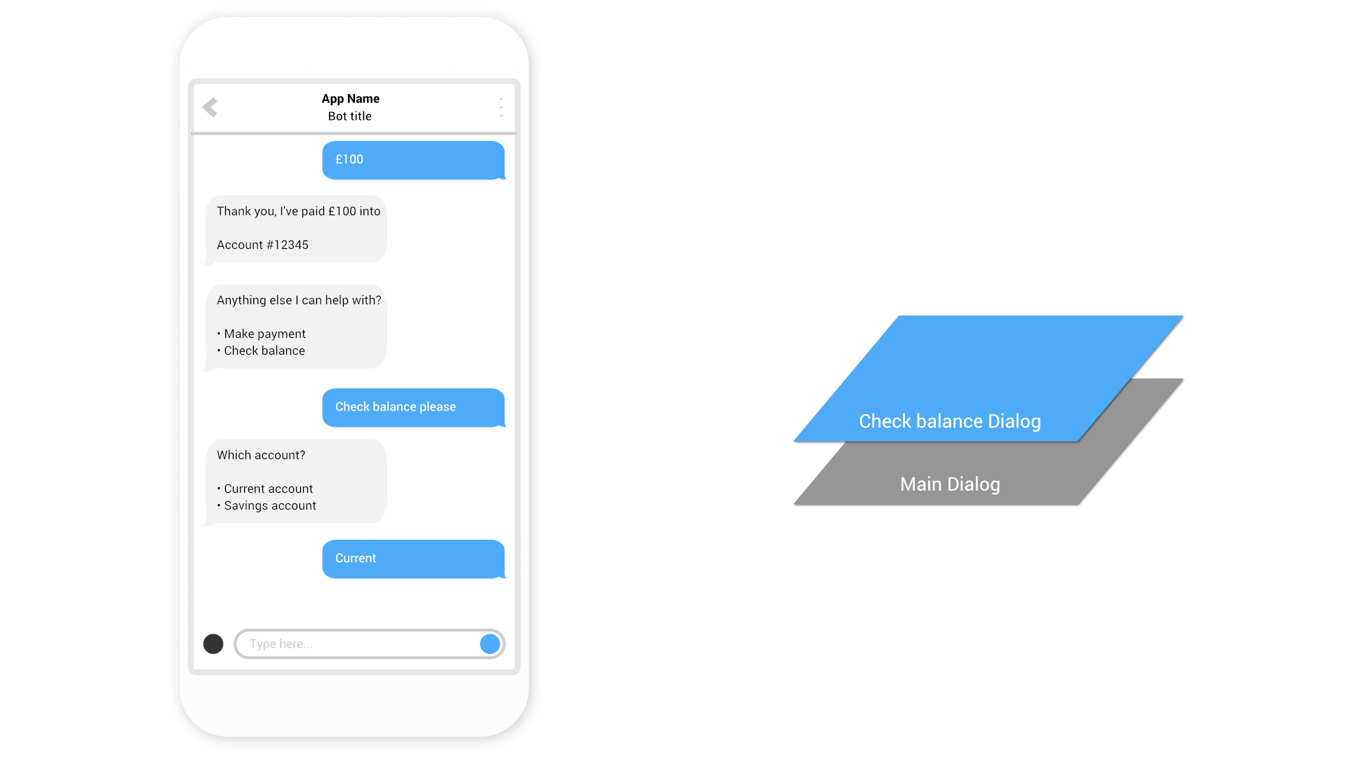

Slide 51
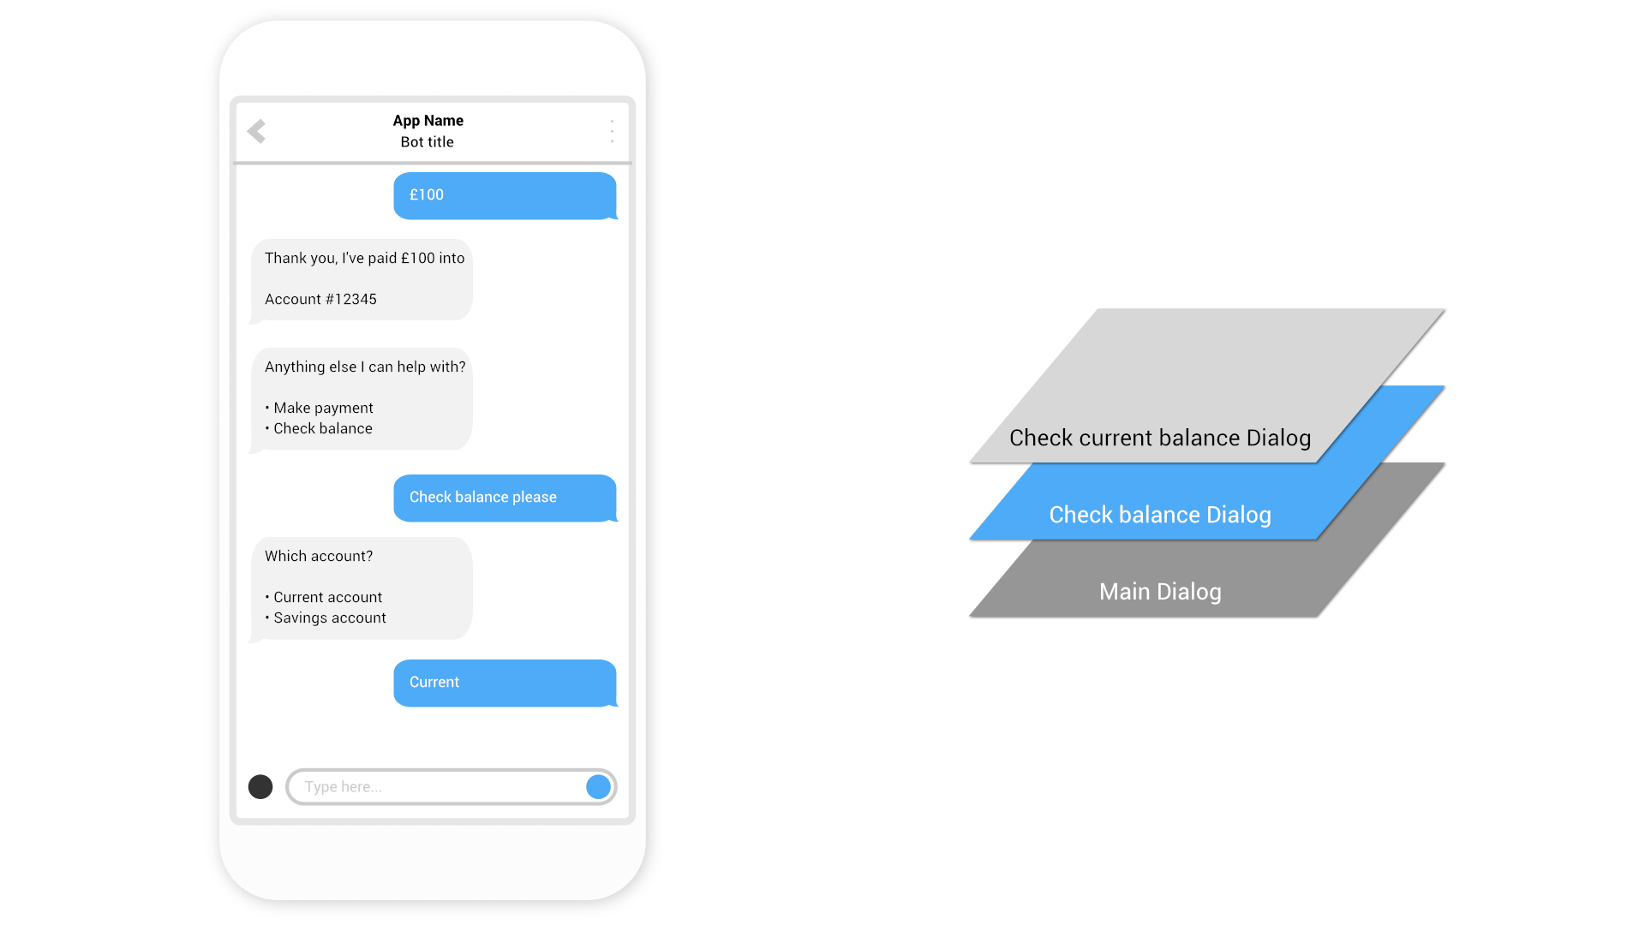

Slide 52
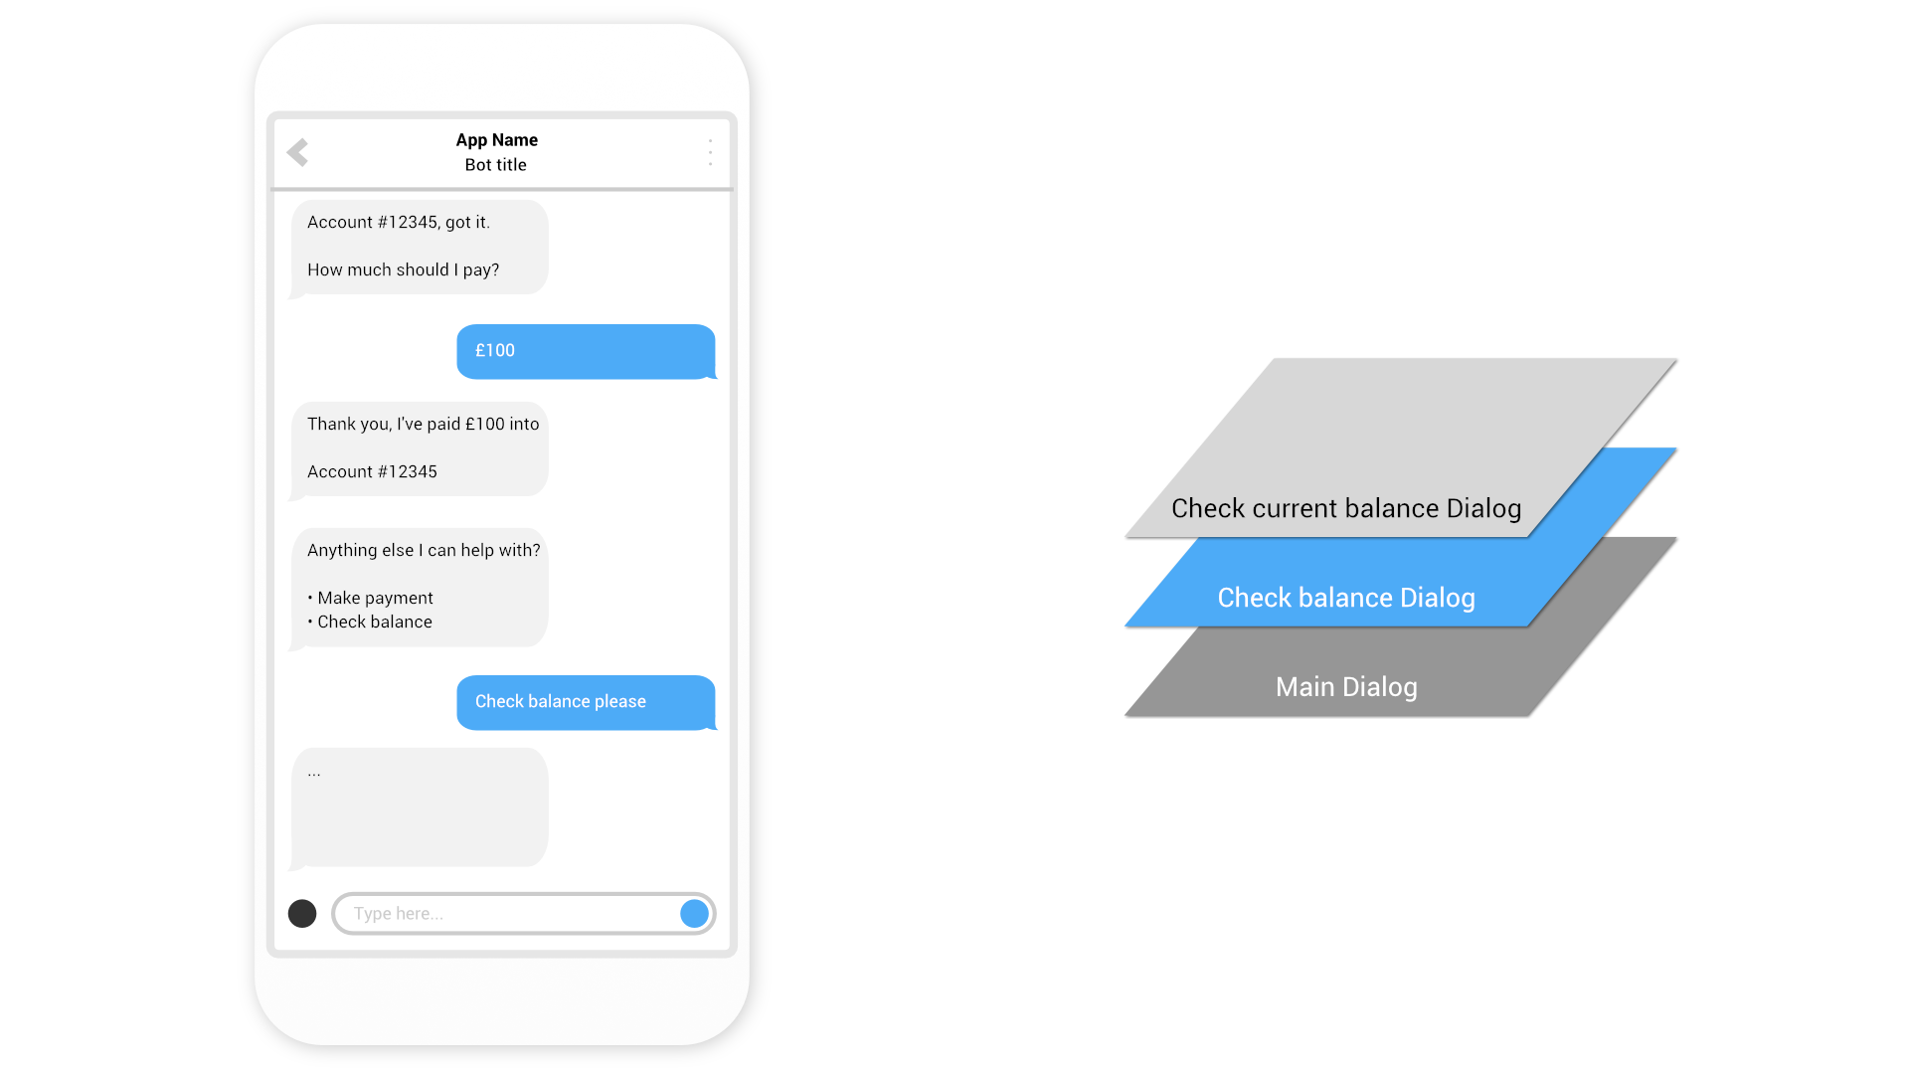

Slide 53
Defining Dialogs
Your bot needs to define top-level dialogs in a DialogSet using either:
Prompts Use DialogSet.Add(string dialogId, IDialog dialog) with *Prompt to add functions that prompt the user for input and process the response
Waterfall Steps Use DialogSet.Add(string dialogId, WaterfallStep[] steps) to add WaterfallSteps which allow the Dialog to flow from one interaction to the next
Composite Dialogs Use DialogSet.Add(string dialogId, IDialog dialog) with DialogContainer to add composite Dialogs that contain other Dialogs
To create an effective conversation it is typical to use a mix of Prompts, DialogContainers and WaterfallSteps

Slide 54
Demo
Banking bot using dialogs
@jamesemann

Slide 55
qnamaker.ai
@jamesemann

Slide 56
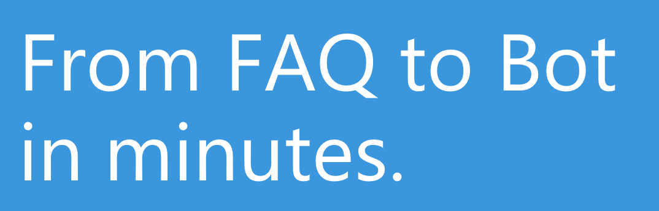

QnA Maker
Build, train and publish
Q&A bots based on existing FAQs
https://www.qnamaker.ai

Slide 57
Demo
qnamaker.ai
@jamesemann

Slide 58
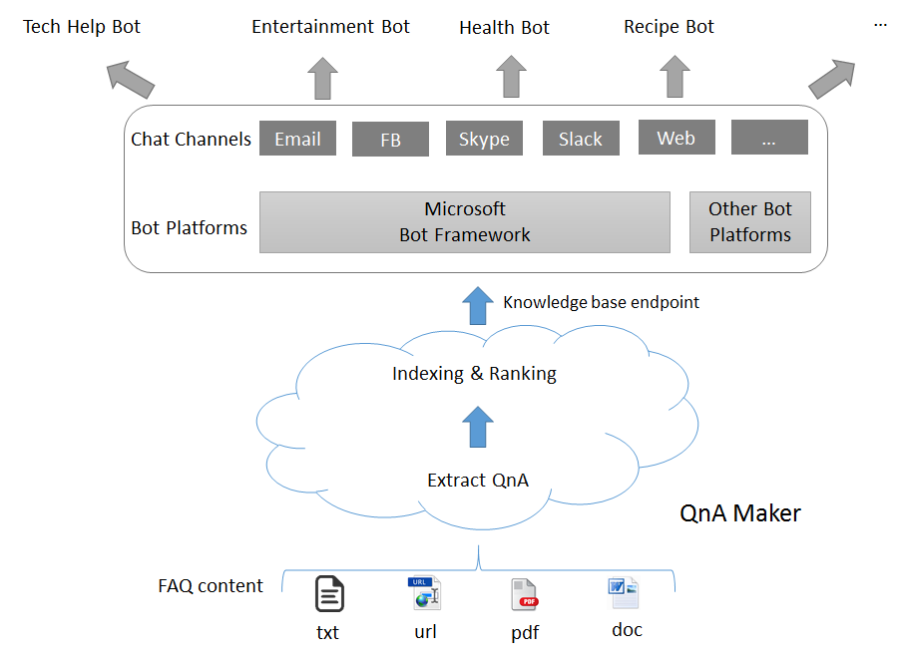
Demo
Banking bot using Dialogs
@jamesemann

Slide 59
Demo
Customer support bot
@jamesemann

Slide 60
luis.ai
@jamesemann

Slide 61
luis.ai terminology
Utterance (input)
A spoken or written message
Intent (output)
What is the user intending to do?
Entity (output)
What objects are being referred to?
“Set the temperature in the kitchen to 21 degrees”
“Set the temperature in the kitchen to 21 degrees”
“Set the temperature in the kitchen to 21 degrees”

Slide 62

luis.ai intent recognition & entity extraction
“Set the temperature in the kitchen to 21 degrees”
“Set the temperature in the kitchen to 21 degrees”
“Set the temperature in the kitchen to 21 degrees”
Intent
Set temperature
Model
(luis.ai API)
Entities
Room = Kitchen
Temperature = 21 degrees

Slide 63
luis.ai components
Portal
Api
Define
Train
Publish
Consume

Slide 64
Demo
Home automation model in luis.ai portal
@jamesemann

Slide 65

A more intelligent bot
Channels
Bot Application
luis.ai
Your bot
Luis Middleware
Model
API Controller

Slide 66
Demo
Home automation bot using luis middleware
@jamesemann

Slide 67
Cards
@jamesemann

Slide 68
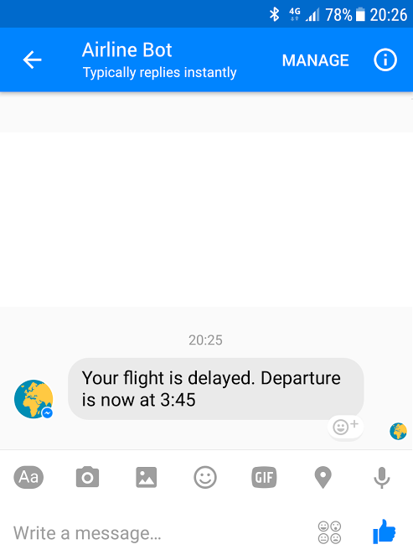
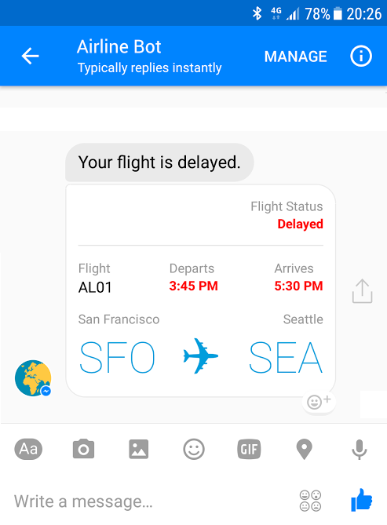
Bots can be more engaging using cards

Slide 69
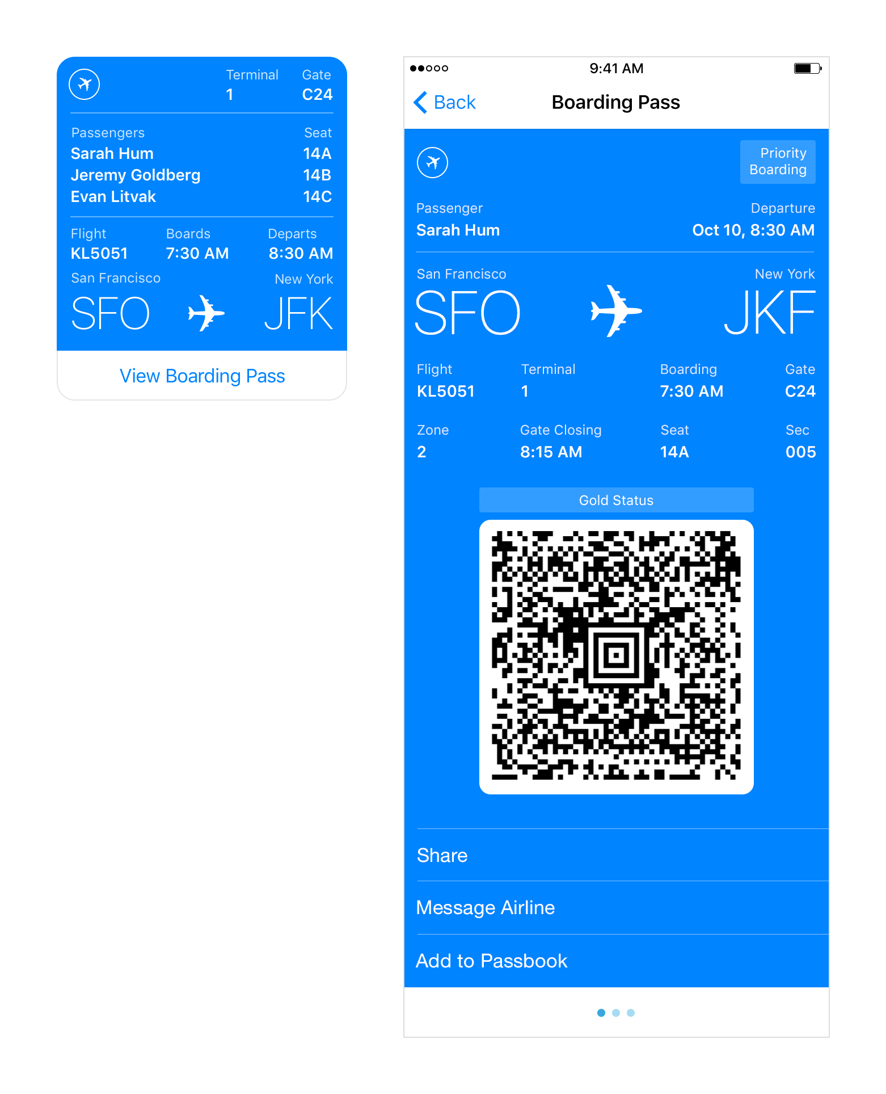
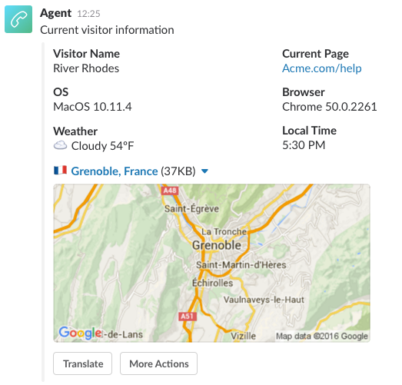
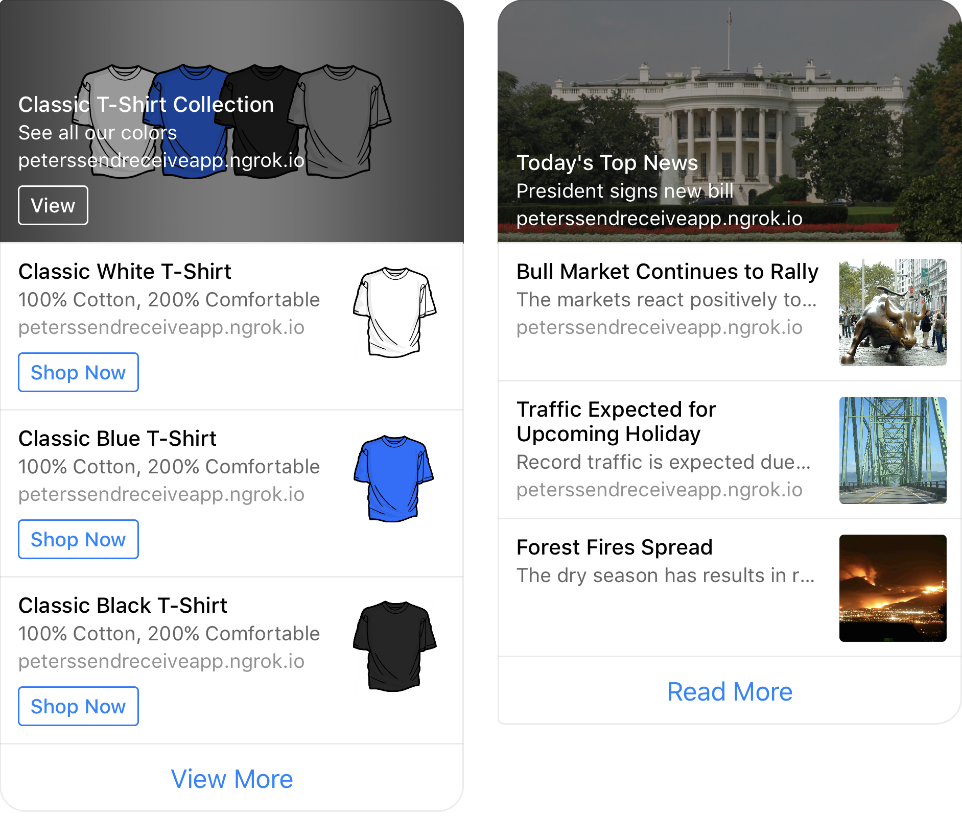
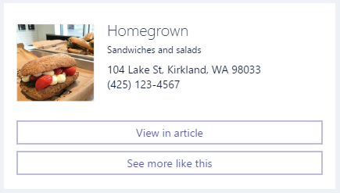
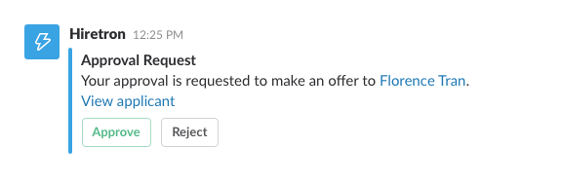
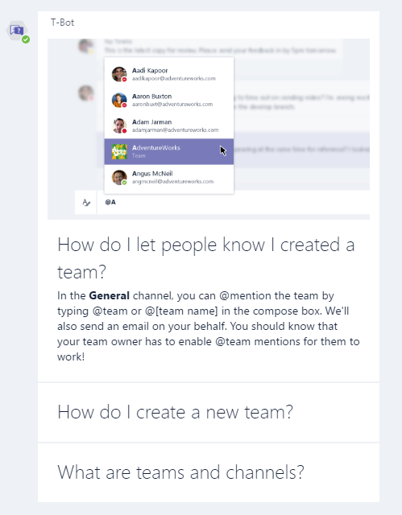
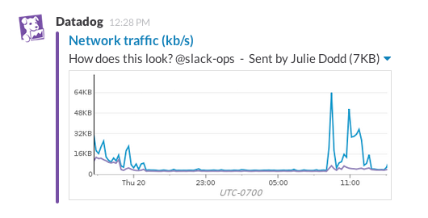

Slide 70
Creating cards using BotBuilder
1. Create activity
2. Create card
3. Add the card to the activities
list of attachments.
IMessageActivity message = context.Activity.CreateReply();
HeroCard card = new HeroCard()
{
Title = $"Appointment with doctor"
});
IMessageActivity message = context.MakeMessage();
message.Attachments.Add(new Attachment()
{
ContentType = HeroCard.ContentType,
Content = card
});

Slide 71
Demo
Cards
@jamesemann

Slide 72
Proactive messaging
@jamesemann

Slide 73
Bot communication isn’t always synchronous
Reminders and alerts
“Your flight is delayed”
Long running tasks
“Started the build… I’ll let you know when it’s done”
“The build is complete”
Human in the loop (human handoff)

Slide 74
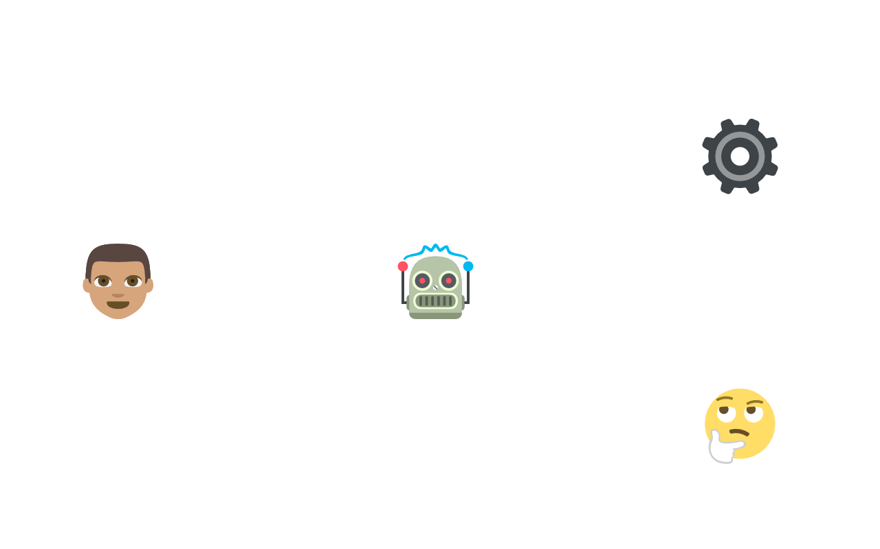


Resuming a conversation
“Business as usual”
“Human handoff”
Bot Application
User
Bot
Customer support

Slide 75
Demo
Customer support proactive bot
@jamesemann

Slide 76
Pricing – as of 21/07/18
Bot Framework
QnaMaker.ai
LUIS.ai
 | Premium Channels (direct line/webchat) | Standard Channels
FREE TIER | £0.373 per 1,000 messages | Unlimited Messages free
S1 TIER | 10,000 messages free per month | Unlimited Messages free
 | Managed documents | Resource costs
FREE TIER | 3 free managed documents; up to 1 MB each | App Service + Azure Search
STANDARD TIER | £7.454/month unlimited managed documents | App Service + Azure Search
 | Text Requests
FREE TIER | 10,000 free transactions per month
LUIS API—Text Requests | £1.118 per 1,000 transactions

Slide 77
Thank you!
Download the emulator + SDK
Start providing a conversational interface to your existing apps!
https://github.com/jamesemann/leedssharp

Slide 78
Resources
Blogs:
James Mann:
blogs.blackmarble.co.uk/blogs/jmann/
Twitter:
@jamesemann
Useful links:
Bot samples, tutorials, case studies:
aka.ms/botresources
Bot framework:
dev.botframework.com
github.com/microsoft/BotBuilder
github.com/microsoft/BotBuilder-samples
Cognitive Services:
aka.ms/cognitive

